Slide 1
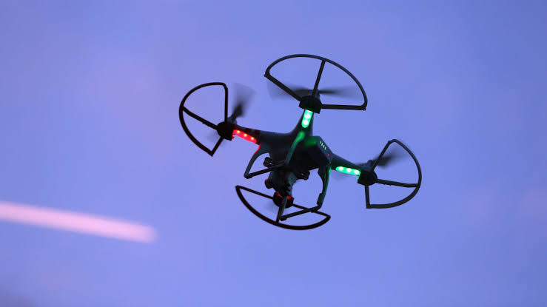
HUMAN COMPUTER INTERFACE OF A DRONE
WHAT IS A DRONE
A drone is a IFO an identified flying object unmanned aircraft or ship that can navigate
Autonomously without human control or beyond line of sight
It can also be guided remotely.

Slide 2
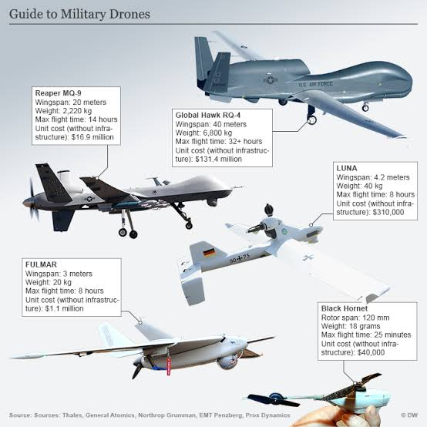
WAR DRONES USED FOR SPYING.

Slide 3
INSIGHT
Drones were initially for non civilian use but over the past 10 years they have become toys controlled by hobbyists. With both drone technology and computing hardware growing lighter, drones can now handle a payload sufficient to carry sensors and actuators this makes using drone interesting for user interface
Drones can be used to research projects for carrying cameras screens and projectors providing a tactile surface and their bare presence in 3D space.
While the public currently perceives drones as dangerous, annoying and loud they are likely to gain social acceptance drones have taken the places of most human in working aspects
drones are now being used to take pictures of landscapes high mountain another planets harzardious to humans

Slide 4
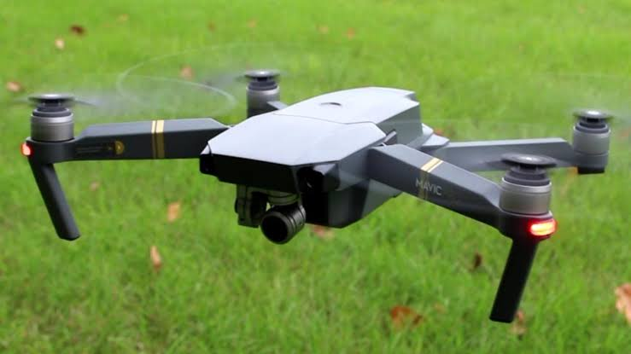
Basic concept of the drone in HCI
The most basic feature of a human drone interaction (HDI) is a user or system telling a drone to change its position with more intelligent system how one controls the drone changes
Direct position control
Absolute position control
Relative position control
Task oriented control

Slide 5
Advantages of HCI in Drones
its serve a substitute for human in hazadious environments e.g other planets, high mountains.
Drones can handle a payload to carry sensors and actuators
Flying cameras, drones can be used for carrying a camera to any position and oriented in 3D space.
Flying screens

Slide 6
Disadvantages of HCI in Drone
most drones are being used to spy on unsuspected individuals
Human error (Logical error) can take place in the calculation of a drone e.g war drones can miscalculate target trajectory and fire at wrong locations
You can spy on naked women tho because its widely accepted it and it can be used without caution for law enforcement
Individuals can use it for various reason good or bad.

Slide 7
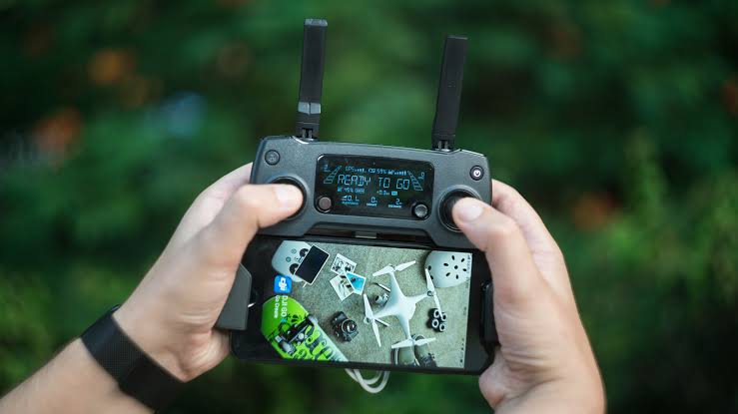
Remote control of a drone

Slide 8
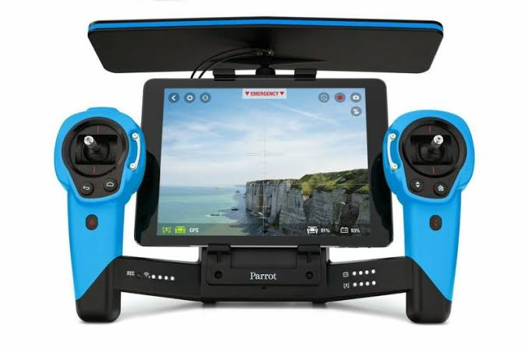
Prototyping human drone interface
for building and flying we need to pay attention to the drone and communication to other system
When creating autonomous system for example when using the basic concept of drones in HCI

Slide 9
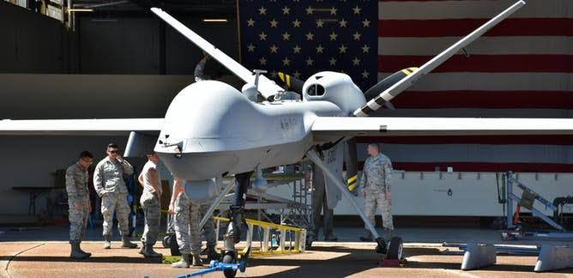
DRONE EQUIPPED WITH MISSILE BY THE U.S ARMY

Slide 10
THANK YOU>

